Slide 1
DATA WAREHOUSE AND BUSINESS INTELLIGENCE
PROF. RICHARD SHERMAN

Slide 2
Retail DW & BI Project
Team 05
Dharit Shah
Luvesh Tekchandani
Ojas Phansekar
Raj Phadke

Slide 3
Overview
Generated Dimensional Model
Integrated Talend Jobs
Implemented BI Tools

Slide 4
Deliverables achieved
1. Documented the BI Roadmap
2. Documented the Source to Target Mappings
3. Integrated the required Dimensions and Facts
4. Created Dashboards based on the integrated data

Slide 5
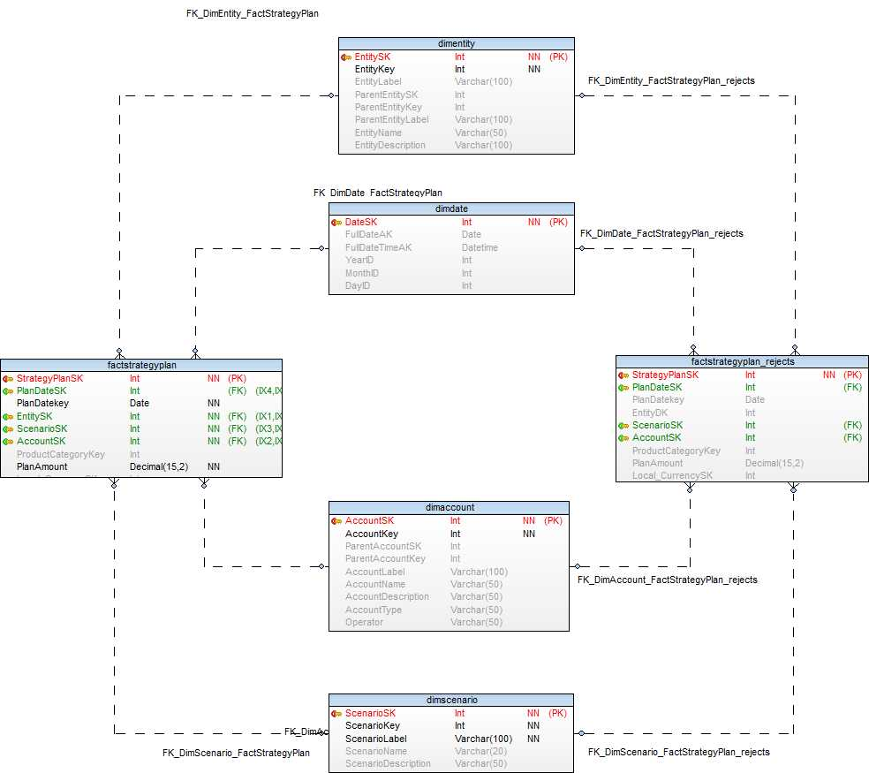
Fact Strategy Plan

Slide 6
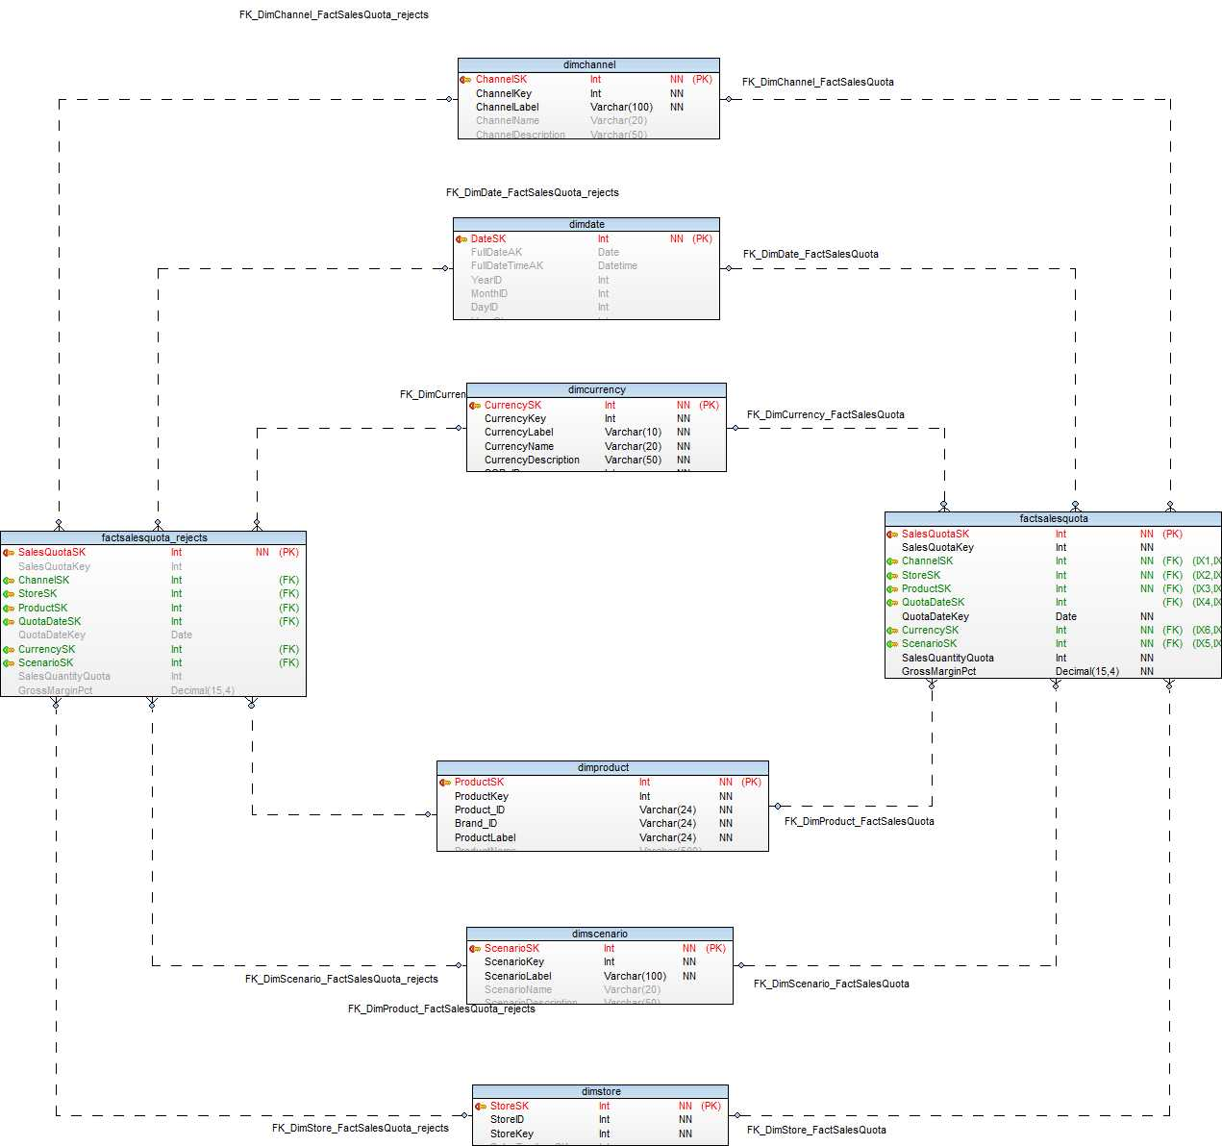
Fact Sales Quota

Slide 7
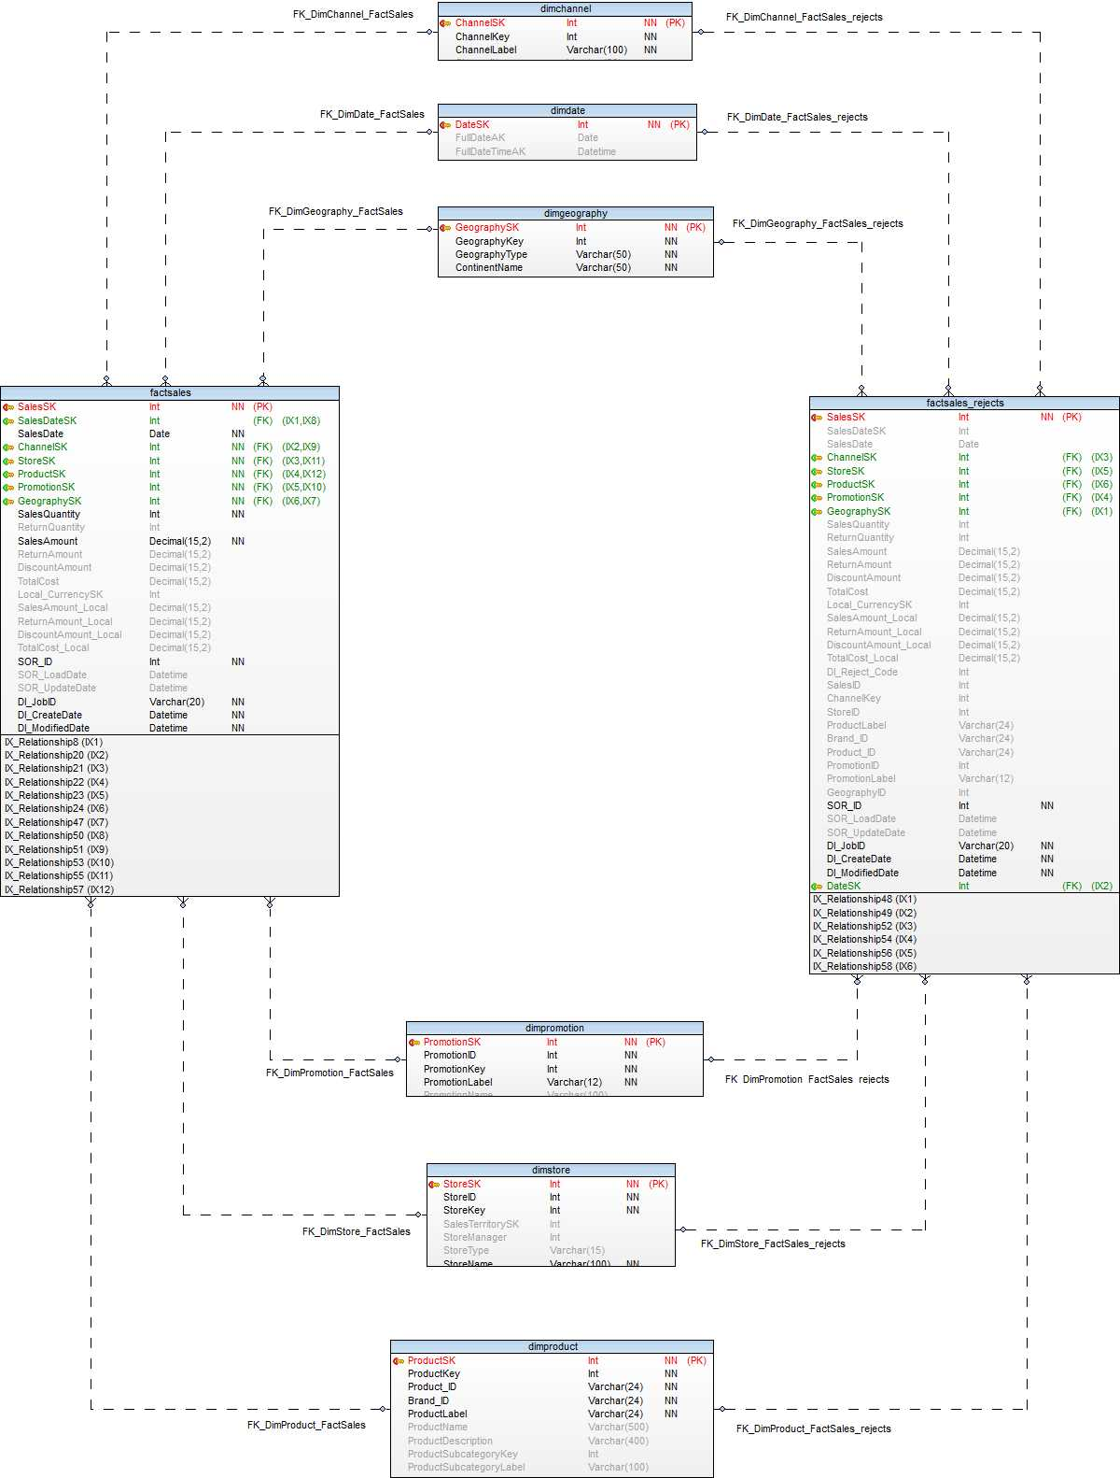
Fact Sales

Slide 8
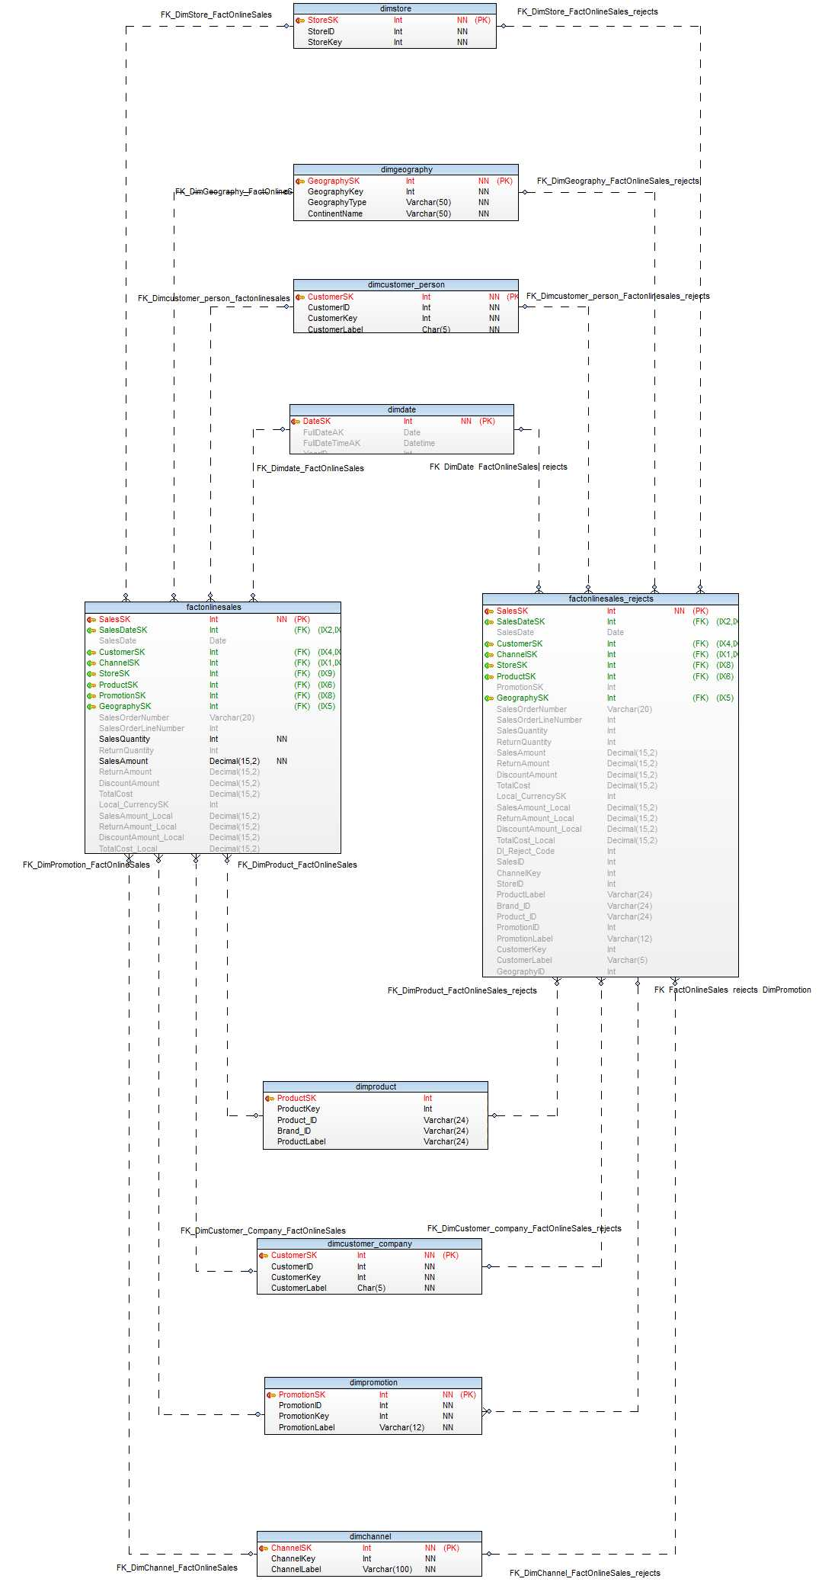
Fact Online Sales

Slide 9
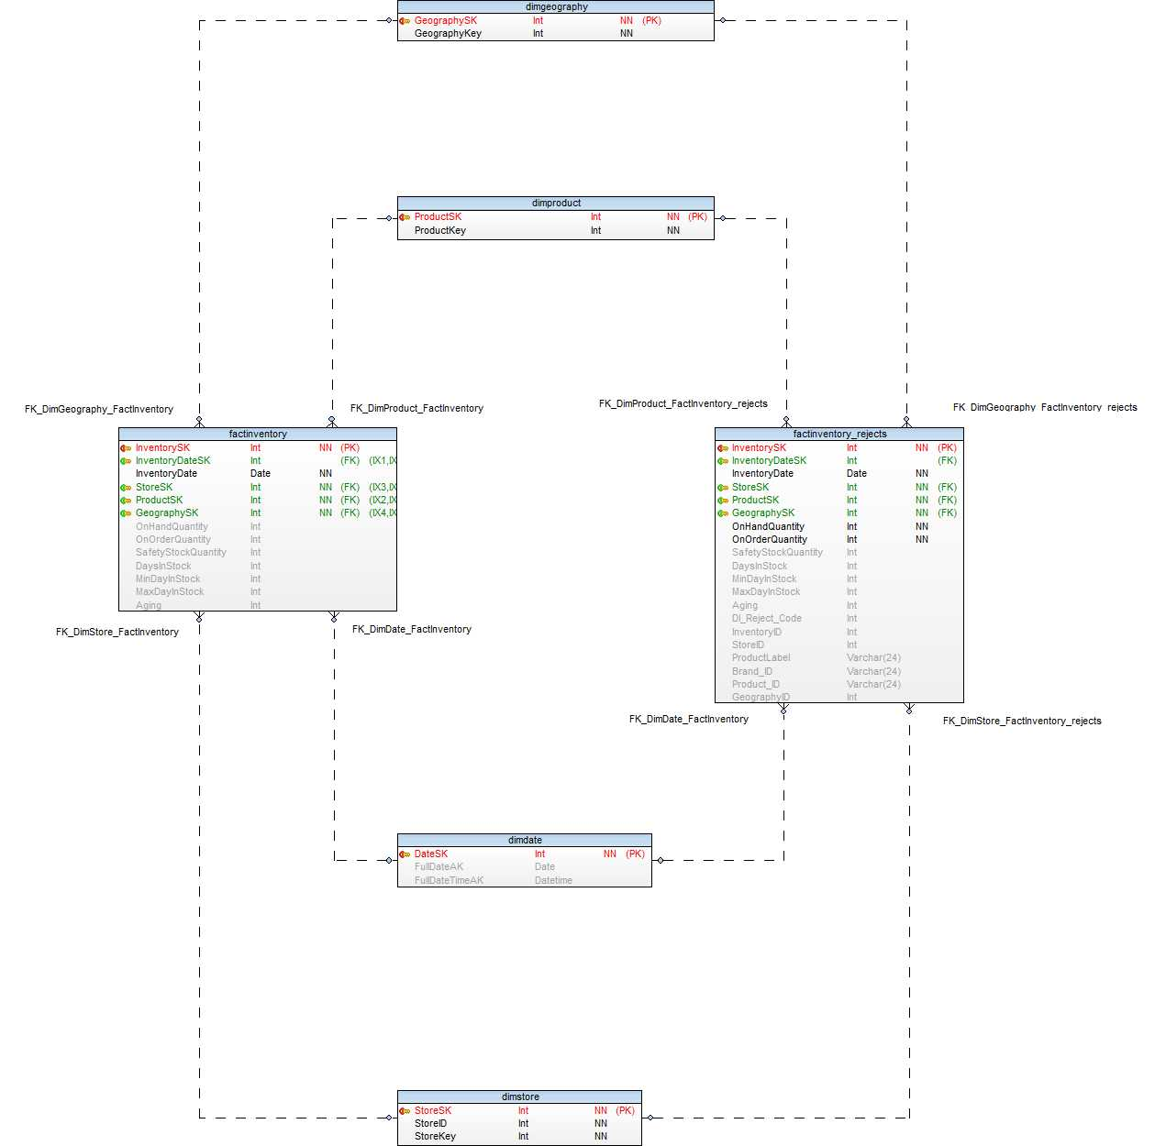
Fact Inventory

Slide 10
Qlik SENSE

Slide 11
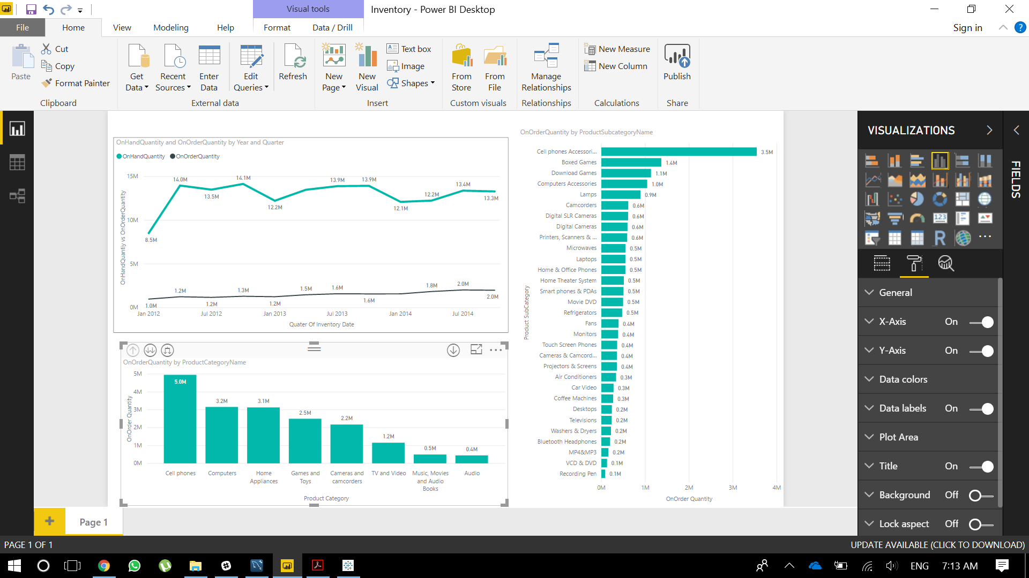
MICROSOFT Power BI

Slide 12


